Slide 1
🗄️ User
Vaults

Slide 2
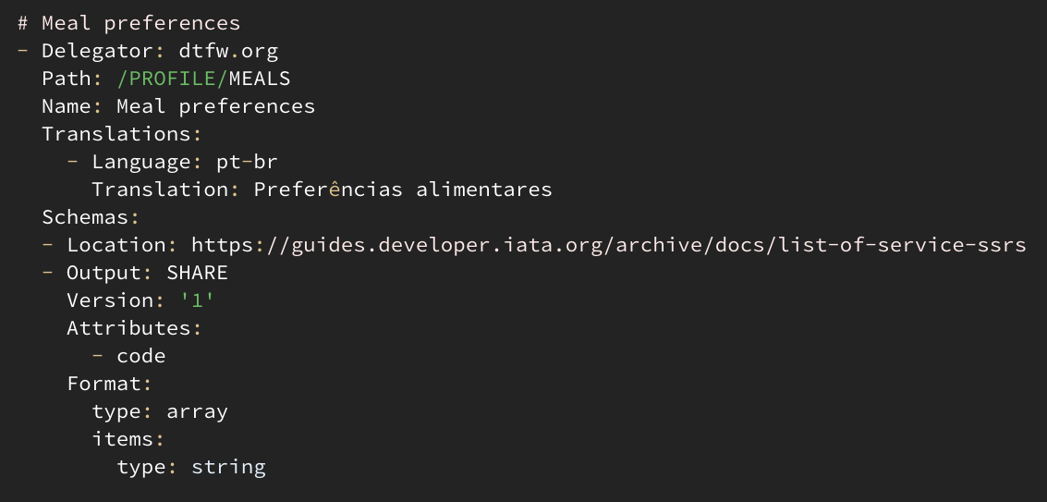
📜 nlweb.org manifest
🏦 Bank
🤵 Broker
💰 Exchange
🤗 Host
🖐️ Palm
💳 Pay
🧢 Persona
📦 Storage
📶 Wi-Fi
🧩 /PROFILE
🧩 //DELIVERY
🧩 //BILLING
🧩 //EMERGENCY
🧩 //ALLERGIES
🧩 //PHONE
🧩 //BOOKING
🧩 //MEALS
🧩 //SOCIAL/NAME
🧩 //SOCIAL/FRIENDLY
🧩 //PARKING
🧩 //TRAVEL/GROUP
🧩 //TRAVEL/SEAT
🧩 //TRAVEL/TAXI
🧩 //TRAVEL/PLACE
CODE

Slide 3
👥 Domain
🧢 Persona
🆔 Identity
💳 Payer
📦 Storage
🏦 Financial agents
🧑‍⚕️ Health agents
others…
🗄️ Vaults
bind
2
hello
1
🤵 Broker
📣
🧑‍🦰 Wallet: App
VAULT

Slide 4
📜 manifest trusts
👥 domain
🗄️ Vault
🎴 Issuer
🗄️
0
{data}
E
1
bind
2
{tokens}
D
disclose
👂 listeners
B
🤵
🕸 Graph
Broker
📣
trustworthy?
🧑‍🦰 Wallet App
tokens
share?
A
C
{tokens}
0
👥 domain
💼 Consumer
📜 manifest trusts
CONSUMER

